Slide 1
©️Naimul Islam Mehedi
Module 1: Introduction to Cybersecurity (Brief Overview)
Defining Cybersecurity: Threats, vulnerabilities, and assets.
The CIA Triad: Confidentiality, Integrity, Availability.
Types of Cyberattacks: Malware, phishing, DDoS, etc.
Introduction to Ethical Hacking: Definition, scope, and importance.
Legal and Ethical Considerations in Cybersecurity.
Different Roles in Cybersecurity: Security Analyst, Penetration Tester, Security Engineer, etc.

Slide 2
Defining Cybersecurity: Threats, vulnerabilities, and assets.

Slide 3
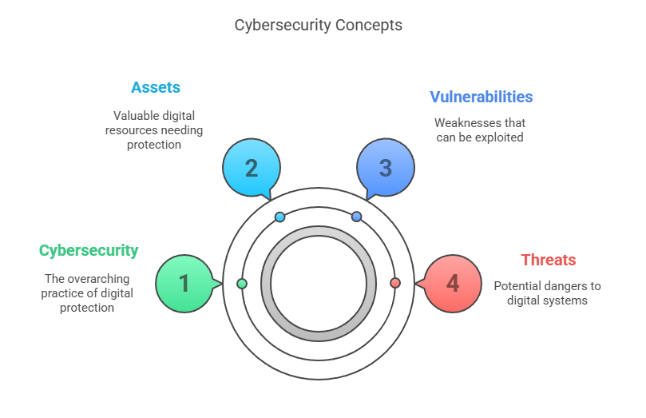
©️Naimul Islam Mehedi

Slide 4
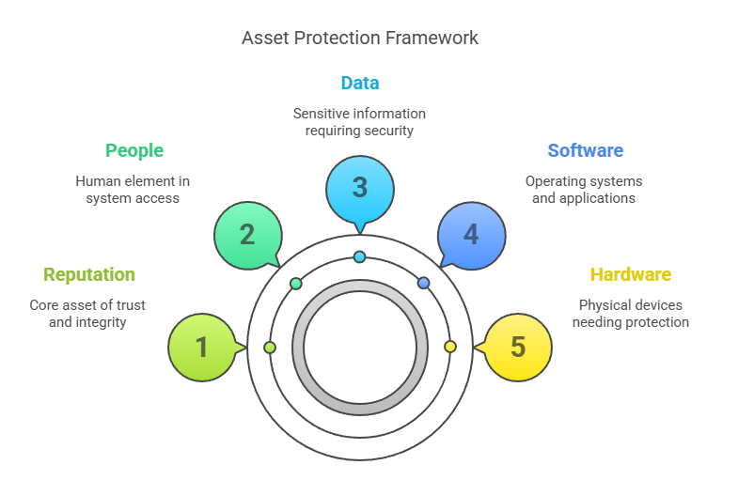
©️Naimul Islam Mehedi

Slide 5
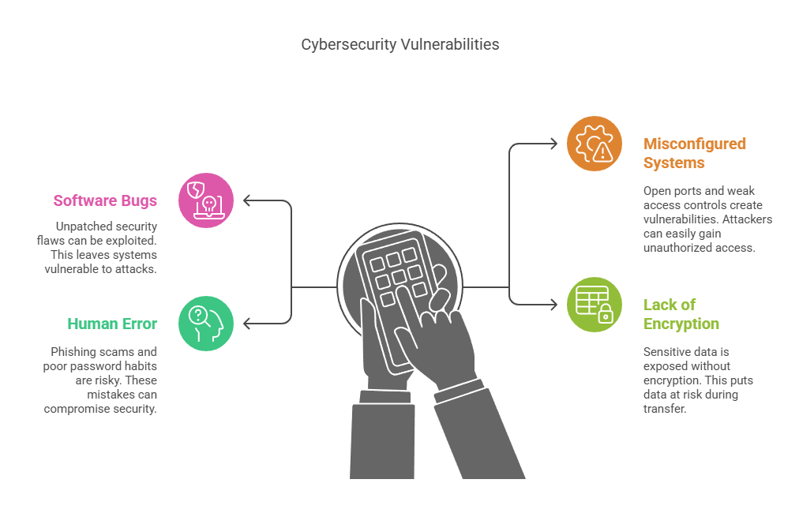
©️Naimul Islam Mehedi

Slide 6
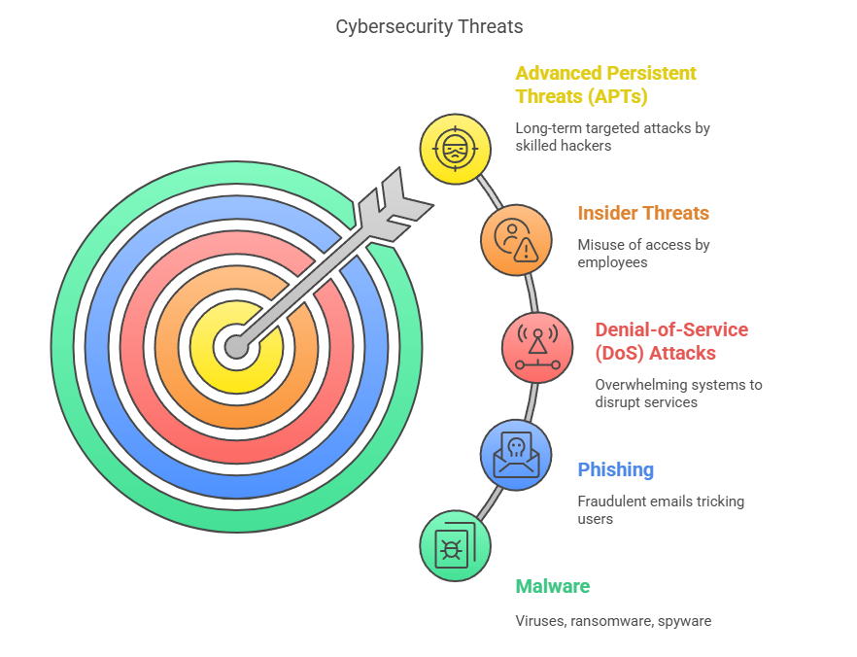
©️Naimul Islam Mehedi

Slide 7
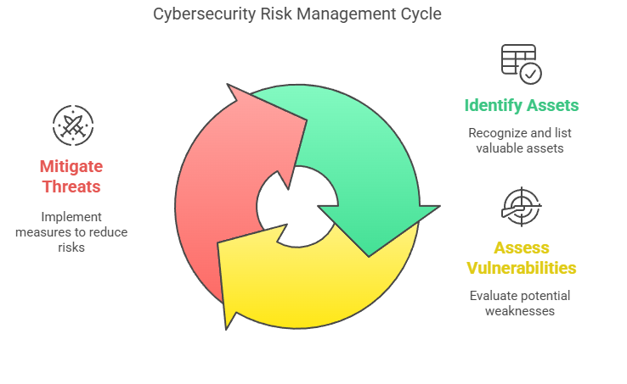
Threat actors (hackers, cybercriminals) look for vulnerabilities to exploit in assets.
Effective cybersecurity involves risk management: identifying assets, assessing vulnerabilities, and mitigating threats.
©️Naimul Islam Mehedi

Slide 8
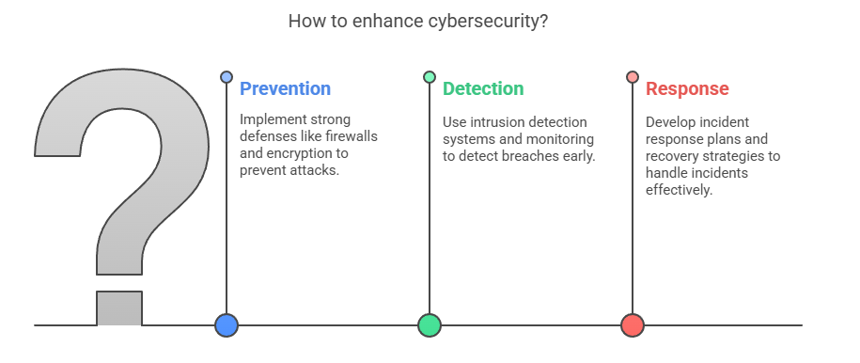
Key Goal of Cybersecurity
To protect confidentiality, integrity, and availability (CIA Triad) of assets by:
Preventing attacks through strong defenses (firewalls, encryption).
Detecting breaches early (intrusion detection systems, monitoring).
Responding to incidents (incident response plans, recovery strategies).
©️Naimul Islam Mehedi

Slide 9
The CIA Triad: Confidentiality, Integrity, Availability.

Slide 10
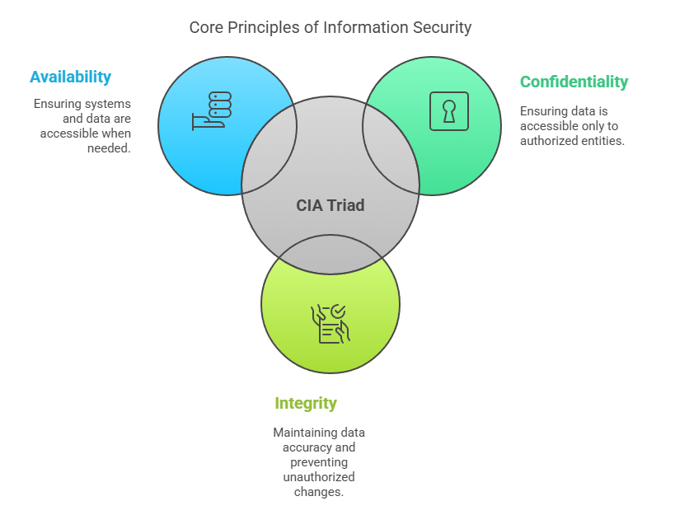
©️Naimul Islam Mehedi

Slide 11
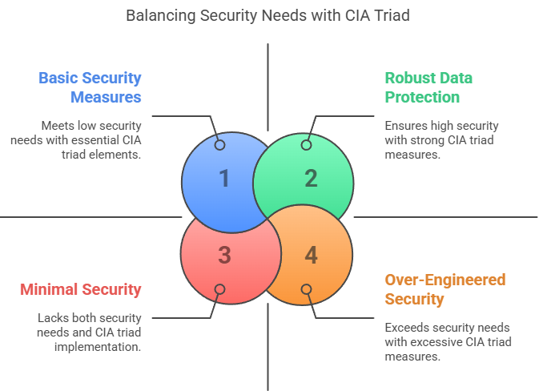
©️Naimul Islam Mehedi

Slide 12
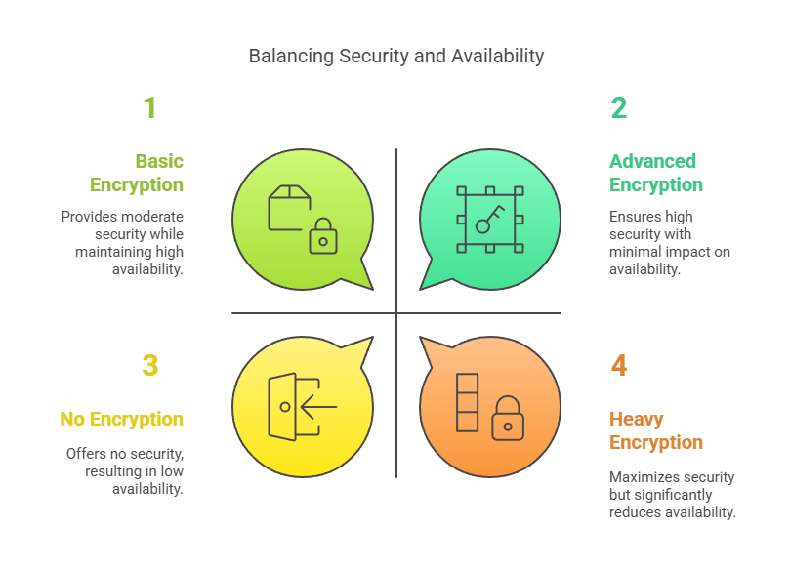
©️Naimul Islam Mehedi

Slide 13
Types of Cyberattacks

Slide 14
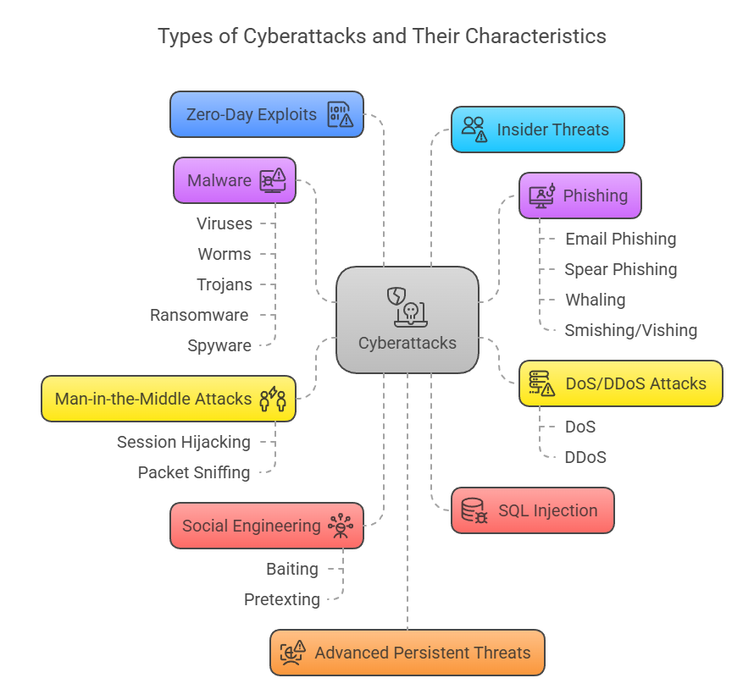
©️Naimul Islam Mehedi

Slide 15
Prevention Measures:
Use strong passwords + multi-factor authentication (MFA).
Keep software updated (patches).
Educate users on phishing/social engineering.
Deploy firewalls, antivirus, and intrusion detection systems (IDS).
Regular backups (to counter ransomware).
©️Naimul Islam Mehedi

Slide 16
Introduction to Ethical Hacking: Definition, scope, and importance.

Slide 17
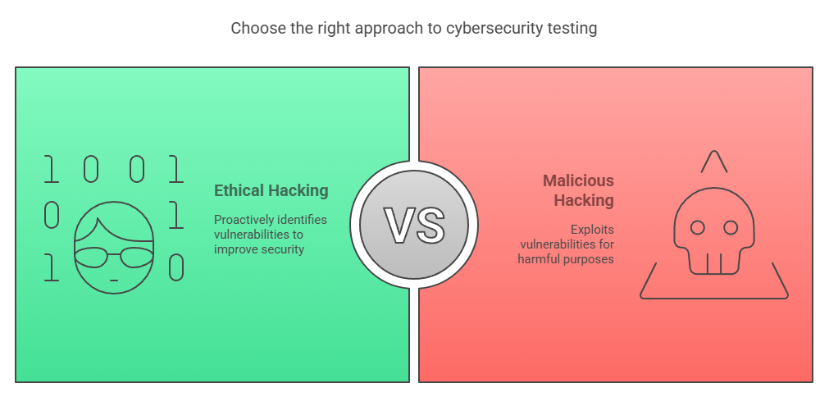
Ethical hacking (also known as penetration testing or white-hat hacking) is the authorized practice of bypassing system security to identify potential vulnerabilities that malicious hackers (black-hat hackers) could exploit. Ethical hackers use the same techniques as cybercriminals but with permission to improve security rather than cause harm.
Key Characteristics of Ethical Hacking:
Legal & Authorized – Conducted with explicit permission.
Goal-Oriented – Aims to strengthen security, not damage systems.
Follows a Code of Ethics – Adheres to professional and legal standards.
©️Naimul Islam Mehedi

Slide 18
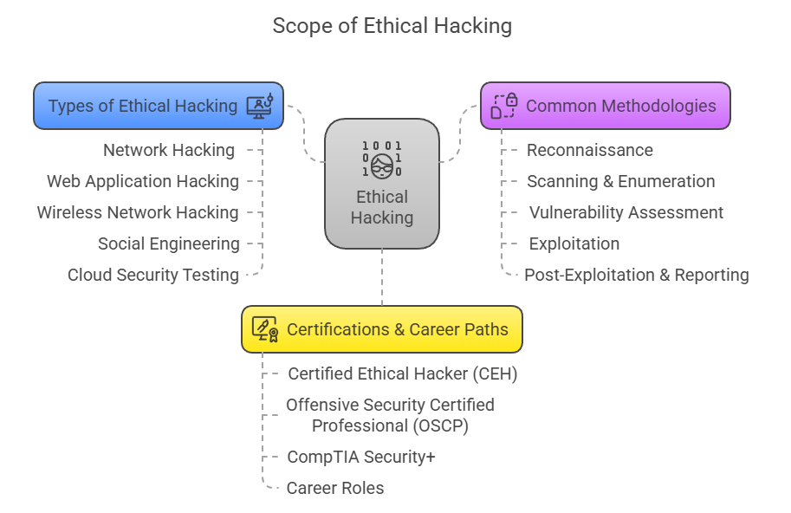
©️Naimul Islam Mehedi

Slide 19
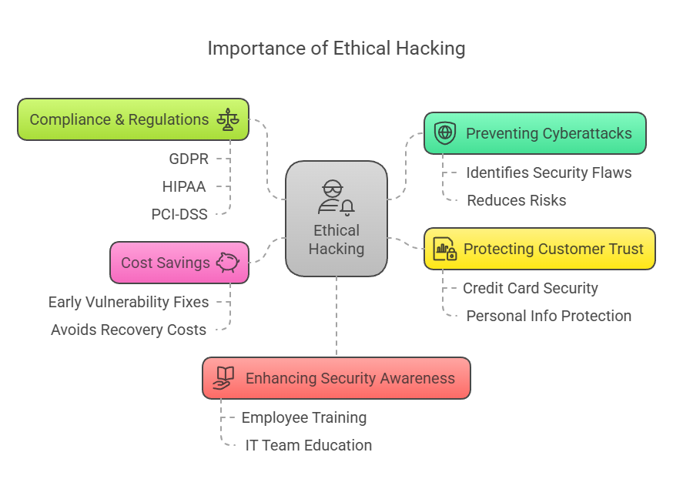
©️Naimul Islam Mehedi

Slide 20
Legal and Ethical Considerations in Cybersecurity.

Slide 21
©️Naimul Islam Mehedi

Slide 22
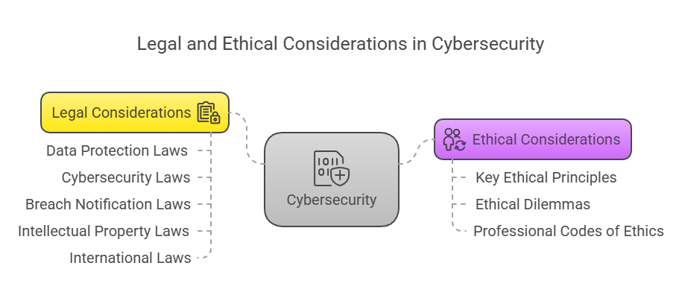
Cybersecurity professionals must navigate complex legal frameworks while upholding ethical standards. Compliance with laws like GDPR and HIPAA is mandatory, but ethical responsibility goes beyond legal requirements to ensure trust, fairness, and accountability in the digital world.
©️Naimul Islam Mehedi

